Slide 1


Welcome to Colville Primary School
‘We Love, We Laugh, We Learn’
Puffins Nursery Class

Slide 2

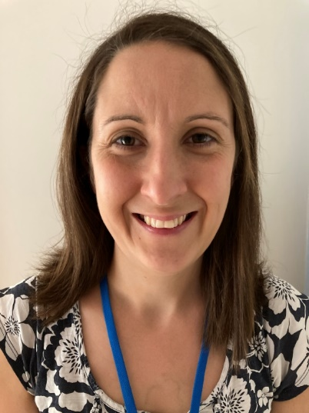

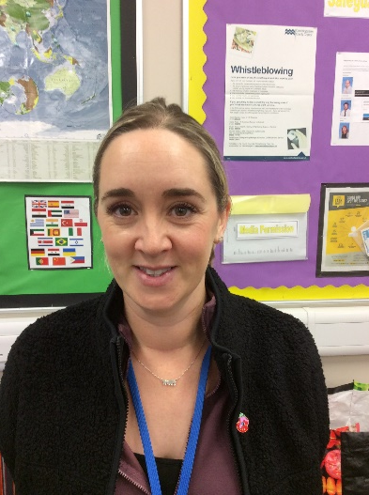
Meet the nursery staff!
Mrs Widdowson
Nursery teacher
Mrs Hulme
Nursery Nurse
Miss Christie
Nursery teacher
(Thursdays)
My name is Rachel Widdowson and I will be your child’s nursery teacher. Mrs Hulme is our nursery nurse. On Thursdays, one of our reception teachers, Miss Christie, leads the class. We look forward to welcoming your child into nursery on their allocated start date. Do spend time looking through the website with your child so they can get to see some of what nursery is like.

Slide 3

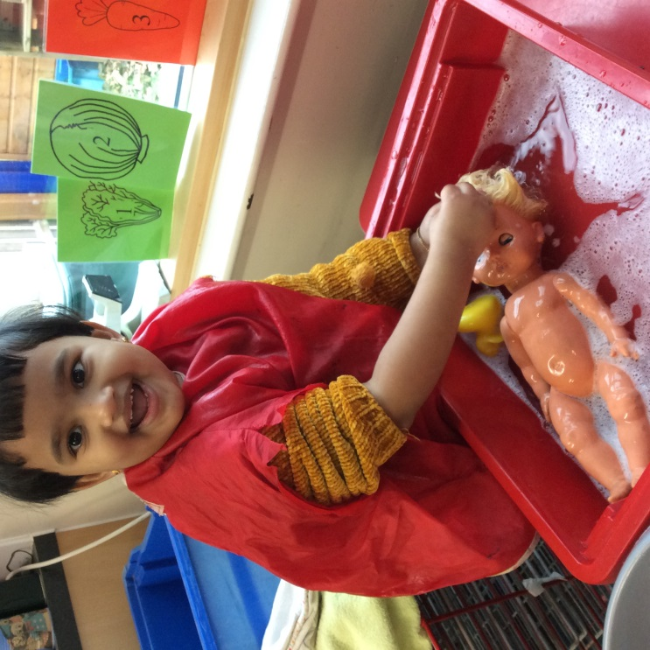
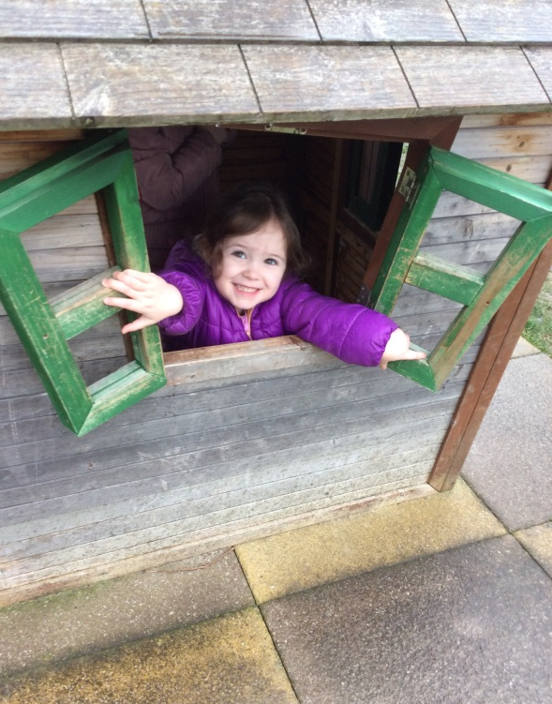
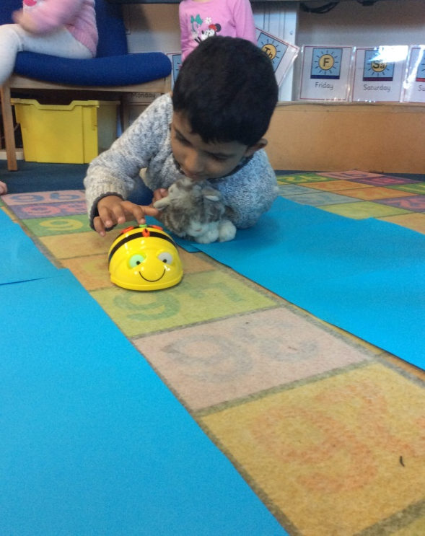
Aims of nursery
The Colville Primary school motto is
‘We Love, We Laugh, We Learn’
And this philosophy starts in nursery.

Slide 4

‘We Love’
Nursery is your child’s first introduction to school. We want them to start off with a real love of learning. We want them to love being here and to come home each day full of excitement about what they have done and eager to return.
Therefore we will spend time and energy trying to get to know your child’s personal interests. We will seek to encourage and engage them through the things they enjoy. We will support them as they learn new things through play.

Slide 5
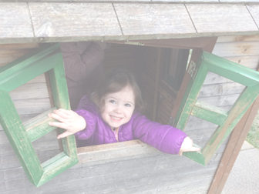
‘We Laugh’
There is a lot of laughter in nursery! Whether we’re laughing at silly stories or funny songs, laughing together as we build crazy constructions or play with water and bubbles, or just enjoying getting to know each other’s sense of fun and adventure. Each day should be full of smiles!

Slide 6
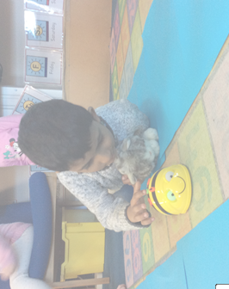
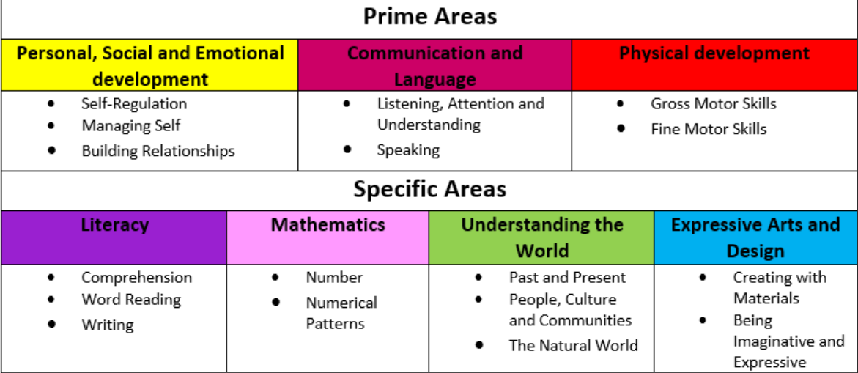
‘We Learn’
The key areas of the Early Years Curriculum are:
We will keep you updated regularly on how your child is achieving through the online Tapestry system, parents
evenings and school reports. You are also welcome to chat
with us at any point about how your child is doing.

Slide 7

Starting Nursery
Starting nursery can be a very exciting, but maybe a little daunting, time.
Please do fill in the All About Me form in the pack that was sent home. This way Mrs Hulme and I can get an idea about what your child likes (and doesn’t like!) before we meet them and can hopefully ensure toys and activities are available that will most excite them.
Please also take time to talk with your child about nursery. Walk to the school a few times over the summer and point out the nursery playground. Show them the photos on our website and talk about what they’re most looking forward to playing with.
You will be invited to a Play & Stay session one afternoon in the term before your child starts.

Slide 8
What happens in nursery?
The majority of our time is child led and adult supported play. We believe that children learn best when engaged in something that truly interests them. Your child will be able to choose freely between playing indoors and outside and we have a large variety of toys, games and equipment in both spaces. As they play, the teachers will look for opportunities to extend each child’s learning through questioning and suggestion of additional activities.

Slide 9
What does my child need to be able to do before they start nursery?
Please try and encourage your child to become independent with the following before nursery starts:
* Hand washing
* Toileting
* Putting on their coat
However, we do of course understand that they are young, and will help where needed!

Slide 10
A nursery day
Nursery starts at 9am
Your child will be encouraged to enter nursery on their own and to hang up their coat and bag. They will self register with their name card and then choose their first activity of the day.
The adults will encourage, support and deepen the children’s learning through their play. Sometimes we will have specific activities for them to try, other times we will be led by the children. During each morning we will have circle time all together to sing, listen to stories and discuss what we’ve been doing.
The children will be given a snack of fruit and milk or water during the morning.
Our morning ends at 12. Please let us know who is allowed to collect your child, and do phone the office if this has to change at any point. We cannot let your child go with someone new without permission.

Slide 11
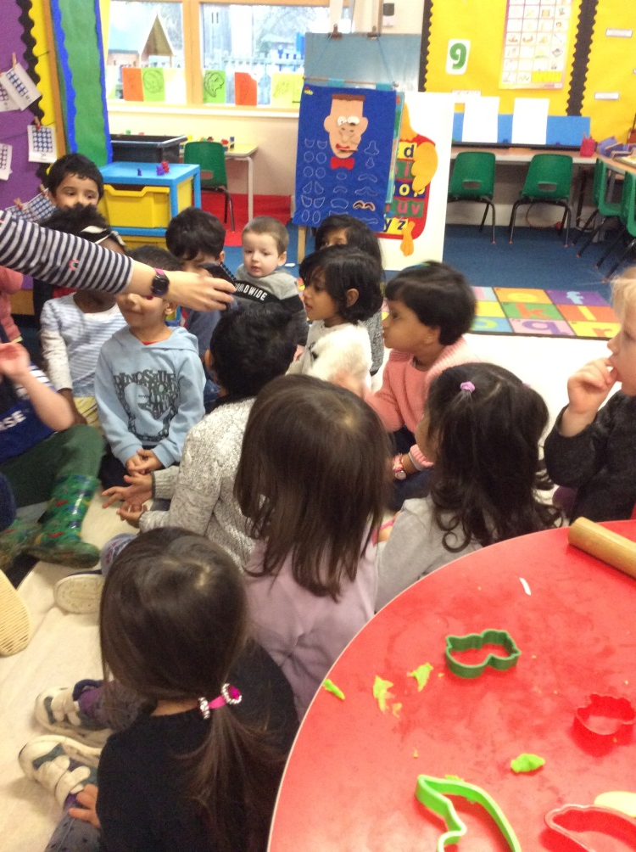
Circle Time
We will usually bring the children together once or twice a session. During
this time we might talk about
specific topics that are of
interest, sing songs together
or listen to a story. Later in the
term we will start to learn
some letter sounds together.

Slide 12

What should my child wear?
We will be spending our time running around, painting, playing with play dough, digging in mud and splashing in water. Please make sure your child is dressed in suitable clothes that you don’t mind getting dirty!

Slide 13
What should my child bring?
* Please bring a named coat each day. We love being outside whatever the weather
* Please also bring a spare change of clothes in a named bag. This is useful if your child gets wet playing with water or if they have a toileting accident. If you wish, they can leave their bag on their peg throughout the week rather than bringing it in each day
* A named water bottle would be useful. We will also provide cups of drink during the morning
* Once the class have settled in, your child will be given a free book bag to take home a book each week. Do not buy a book bag!

Slide 14
How can I communicate with the school?
* School email office@colville.cambs.sch.uk
* Phone number 01223 576246
* Teacher email RWiddowson@colville.cambs.sch.uk
* Feel free to have a quick chat with members of staff when dropping off or collecting your child. For longer talks it will be best to make an appointment so that we can chat uninterrupted
* There will be a parents evening in both the Autumn and Spring term and written reports in July
* You will receive weekly school newsletters via email from Mr Hastings

Slide 15

We are so excited about meeting your child and we hope they are excited too!

