Slide 1

Welcome to Colville Primary School
‘We Love, We Laugh, We Learn’
EYFS Parents Induction Meeting
www.colvilleschool.co.uk

Slide 2
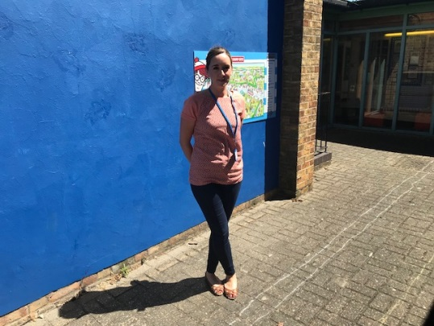
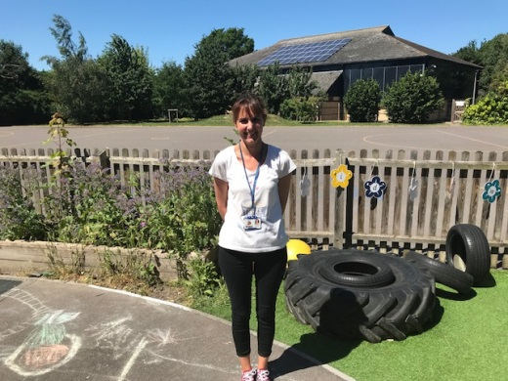
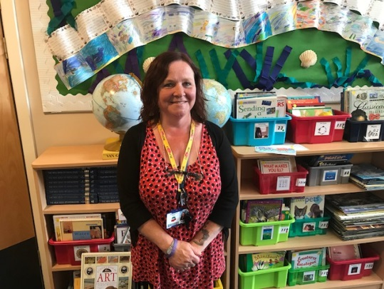
Meet our Reception Team!
Miss Christie – Class Teacher
Mrs Harper – Teaching Assistant
Mrs Rollings –
Teaching Assistant
Hello!
My name is Charlotte Christie and I will be your child’s class teacher. It is a shame
that I can not carry this meeting out in person but I have added some key information that will hopefully answer some of your questions and put your mind at ease. I look forward to welcoming you all in September!

Slide 3
In your packs you should have received the following:
Road to school: this document is really useful in helping you prepare your child for starting school. It is a big event in your child’s life and we want them to be as ready as they can be. Please don’t expect your child to be able to do all of these things but do begin working on the ones you feel are achievable. We are aiming for happy, independent children!
‘All About me’ sheet to complete with your child: this is really important so that we can begin getting to know your child from day one. Fill it in and return alongside your other forms.
Early Years Foundation Stage Framework: An overview of the curriculum your child will be taught from. I will carry out a parents meeting, when possible, to explain it in full.
Things to do at home: This helps translate the curriculum into what it may look like at home.
Tapestry form: Please complete and return and we will carry out an information meeting as soon as possible.
Dietary requirements: Let us know of any allergies or dietary requirements that your child may have.

Slide 4
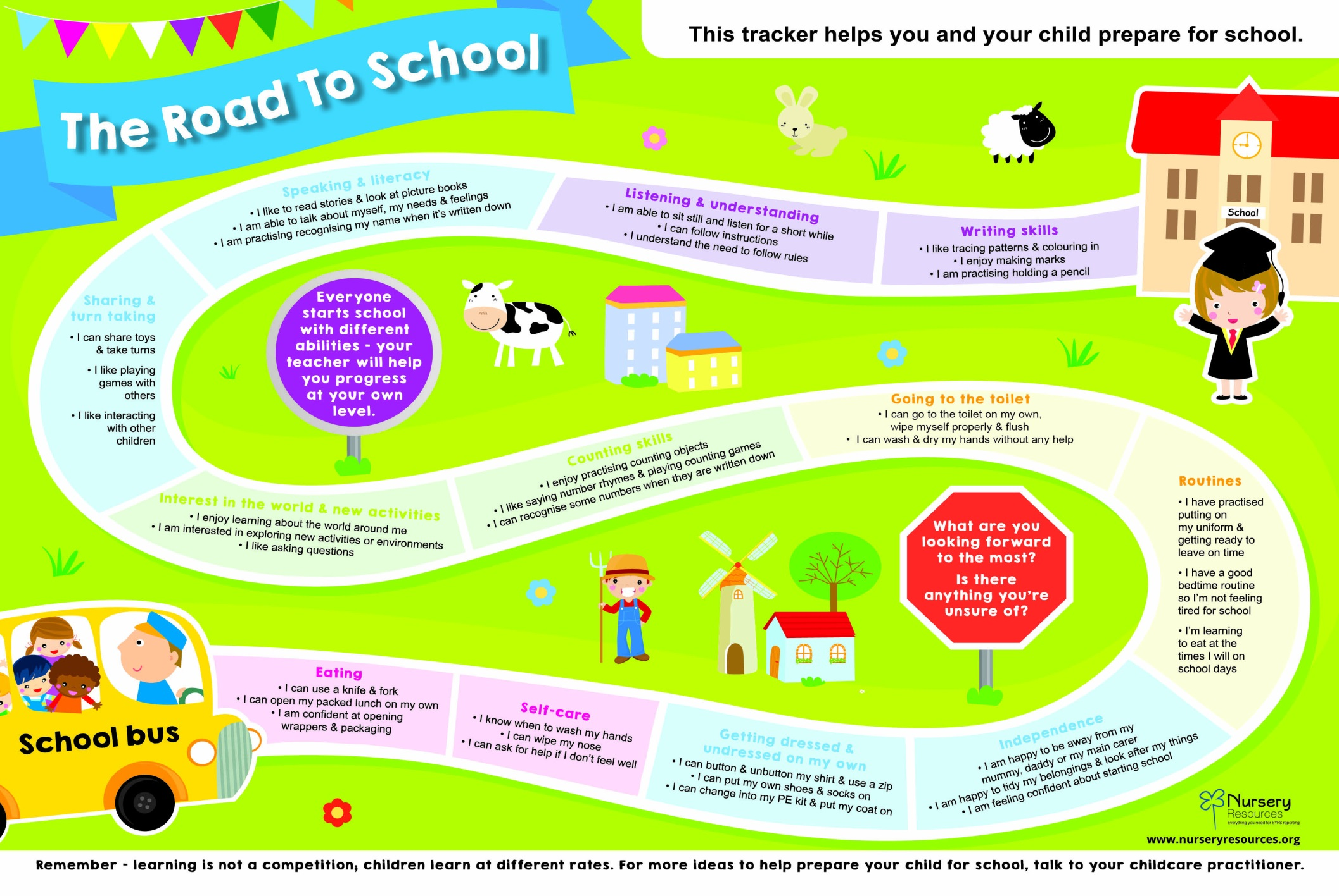
Is your child school ready?

Slide 5


On the following slide you will see a timetable of an ‘average’ day in Reception. This is what we will be working towards once the children have transitioned into school and feeling settled. Not every day is the same but this will give you a good idea of what your child has been up to, especially when they come home and say they have been doing ‘nothing’ all day!
You will see the phrase Continuous Provision used throughout. This is when children have access to their learning environment where they can independently choose what they would like to play with. The Foundation Stage (Nursery and Reception) is built on the ethos of learning through play so children have lots of opportunities to do this alongside adult directed activities.

Slide 6
An ‘average’ day in Reception
 | Activity/Focus
8:55am | Children come in independently and find their peg. They go into the classroom, self-register and access continuous provision
9:00am | Come together for Register/calendar time
9:15am | Phonics carpet session
9:30am | Phonics groups/activities. Children can access continuous provision including outdoor area
10:15am | Wash hands for fruit and milk time, share a story or a song
10:30am | Maths carpet session
11:00am | Maths groups/activities. Children continue to access provision
11:50am | Wash hands for lunch. Down to the big hall for lunch
12-1:00pm | Lunch. Children join whole school on the playground.
1:00pm | Topic carpet session
1:30-2:30pm | Understanding the World/Expressive Arts and Design/Physical Development activities (Inc. P.E. sessions)
2:30-3:00pm | PSED/Story/Songs
3:00pm | Home time

Slide 7

We do not yet have the exact start date of school for Reception but we will contact you with that information as soon we can. Once we know more I will be able to give you all the necessary information for the first days and weeks of school.
But for now I have created some Frequently Asked Questions that may help you and your child be prepared for September…
What time does school start and finish?
The whistle will blow at 8:55am each morning for your child to enter school and collection is at 3:00pm. Please let me know if there will be somebody different picking up your child from school as we will not release your child unless we have had confirmation.
What do they need to wear?
The Colville school uniform consists of red or navy blue jumpers and cardigans. The children can wear trousers, shorts, skirts and dresses in black or grey with a white top. The uniform does not have to be logoed.
What do they need to bring?
Each child will be provided with a free book bag (so do not order one). Make sure your child is dressed for the weather as we like to get outside as much as possible!

Slide 8
How does lunch work?
Your child is entitled to a free school meal each day, you can provide them with a packed lunch if you prefer. We all sit together in the school hall and the children are encouraged to do as much as they can independently; feed themselves, cut their food, clear their own plates etc.
Will they get provided with fruit at school?
Children will be provided with a piece of fruit and a glass of milk or water each day. We come together mid-morning and enjoy fruit time as a class.
Does my child need a water bottle?
Currently the class water fountains have been switched off so children will need to bring in a named water bottle each day.
What do I do if my child is ill?
You must contact the school office to let us know that your child will not be in school. If your child comes down with a stomach bug or sickness they must stay off school for 48 hours. If you child needs medication to be administered during the school day you will need to fill out a form to give us permission (forms available from the office).
Please make sure we always have your most up-to-date information so we can contact you if your child falls ill at school.

Slide 9
Will my child need a P.E. kit?
Yes, we will have two Physical Education sessions in a week. Your child will need a t-shirt, a pair of shorts and trainers/plimsolls all named in a P.E. bag. All jewellery should be removed before P.E. sessions, if it cannot be removed it will be covered with protective tape.
What happens if my child has a toileting accident at school?
We recommend that every child keeps a spare change of clothes on their peg at all times. This way children can change and feel comfortable at school after any accidents. There may also be times where they end up wet from too much fun in the water tray or a tad muddy from splashing in the mud kitchen. Being prepared really helps!
What happens if my child loses something at school?
This is when it is absolutely crucial that you label everything! It is near impossible to help you find lost items when they do not have names on. Things do get misplaced as the children are learning to take care of their own things but if it is named it makes it a whole lot easier.

Slide 10


I am hoping this has covered some of the very basic questions. I imagine there may be many more that we will discover along the way and as soon as we can we will arrange contact to discuss other areas.
In the meantime, talk to your child about school and show them the photos on our website to let them become familiarised with their new environment. At Colville we understand that this is a big step for the children and you as parents, don’t worry if you think the first day might be very emotional (for all involved!) we are here to support you!
If there is anything you would like to know or think there is some important information I should know about your child, please do contact me on cchristie@colville.cambs.sch.uk
On the following page you will find some useful website links with some helpful advice, reassurance, activities and top tips for September.
Have a wonderful summer and I look forward to meeting you all in September!!

Slide 11




Useful websites for starting school:
https://www.pacey.org.uk/working-in-childcare/spotlight-on/being-school-ready/
https://www.bbc.co.uk/bitesize/collections/starting-primary-school/1
https://small-talk.org.uk/
https://literacytrust.org.uk/family-zone/birth-4/

Slide 12

Member of staff on door daily (unless pressing, best to chat after school)
Child’s reading diary – checked every day
Appointments
Email school office: office@colville.cambs.sch.uk
Email me: cchristie@colville.cambs.sch.uk
Telephone – 01223 576246
Text message service
Please ensure school has your up to date contact details
Paperless school – check website for regular dates
Half termly newsletter sent out
Parents workshops: phonics, reading, maths, Tapestry.
Parents Evenings in Autumn and Spring Term. Reports in July.
www.colvilleschool.co.uk

